Slide 1
Cutaneous Soft Tissue Tumors for Surgical Pathologists
(Spindle cell diagnoses you don’t want to miss!)
Jerad M. Gardner, MD
Dermatopathologist & Section Head of Bone/Soft Tissue Pathology
Geisinger Medical Center
Danville, Pennsylvania, USA

Slide 2
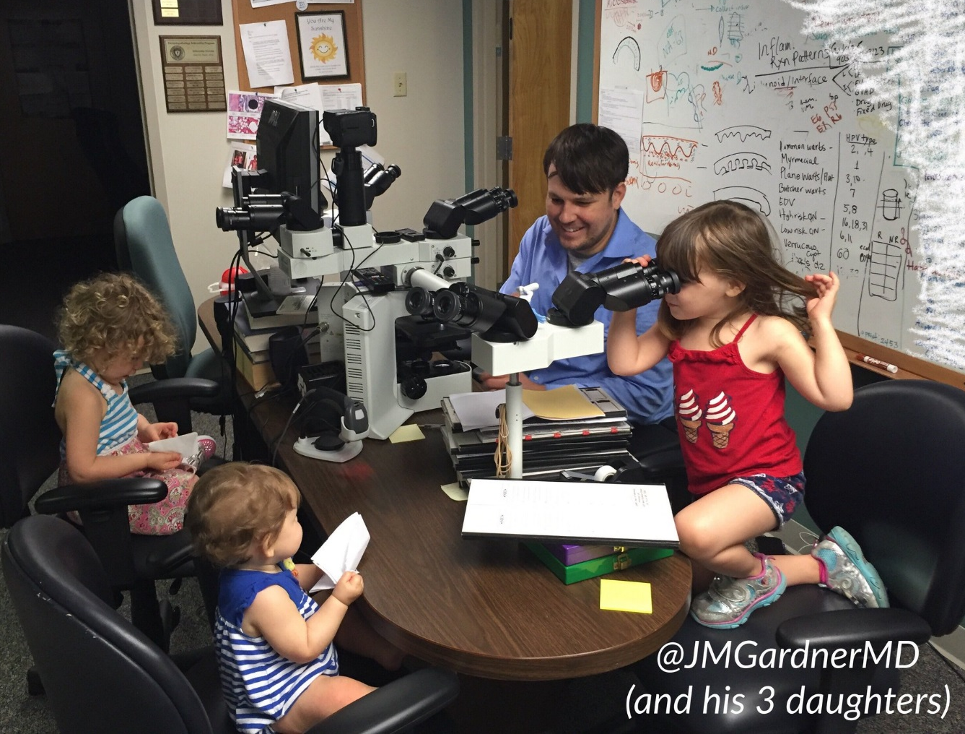
Disclosures
Revenue sharing: YouTube
Stock/Equity Ownership: Kiko, GOOG, APPL, Pathpresenter
Publishing royalties: Elsevier, Innovative Science Press
More COI details: http://bit.ly/coi-jmg
JMGardnerMD@gmail.com
Social Media 101: kikoxp.com/posts/15217
@JMGardnerMD

Slide 3
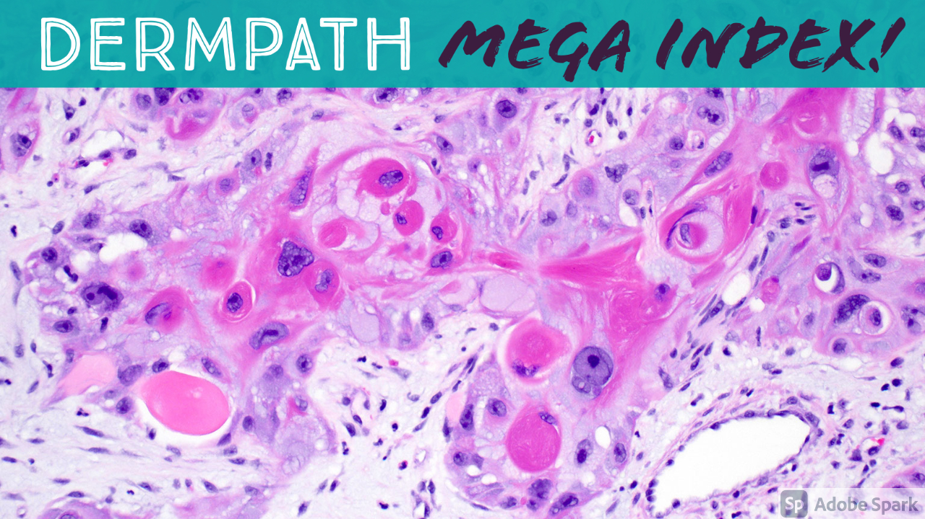
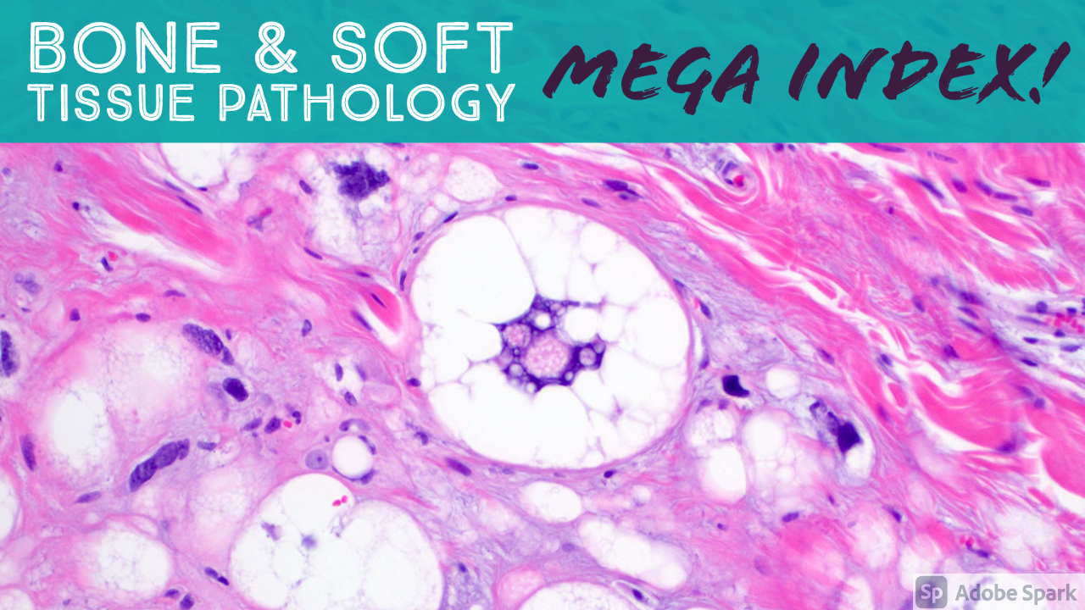
A complete organized library of all my videos, digital slides, pics, & sample pathology reports
kikoxp.com/posts/5084
kikoxp.com/posts/5083

Slide 4
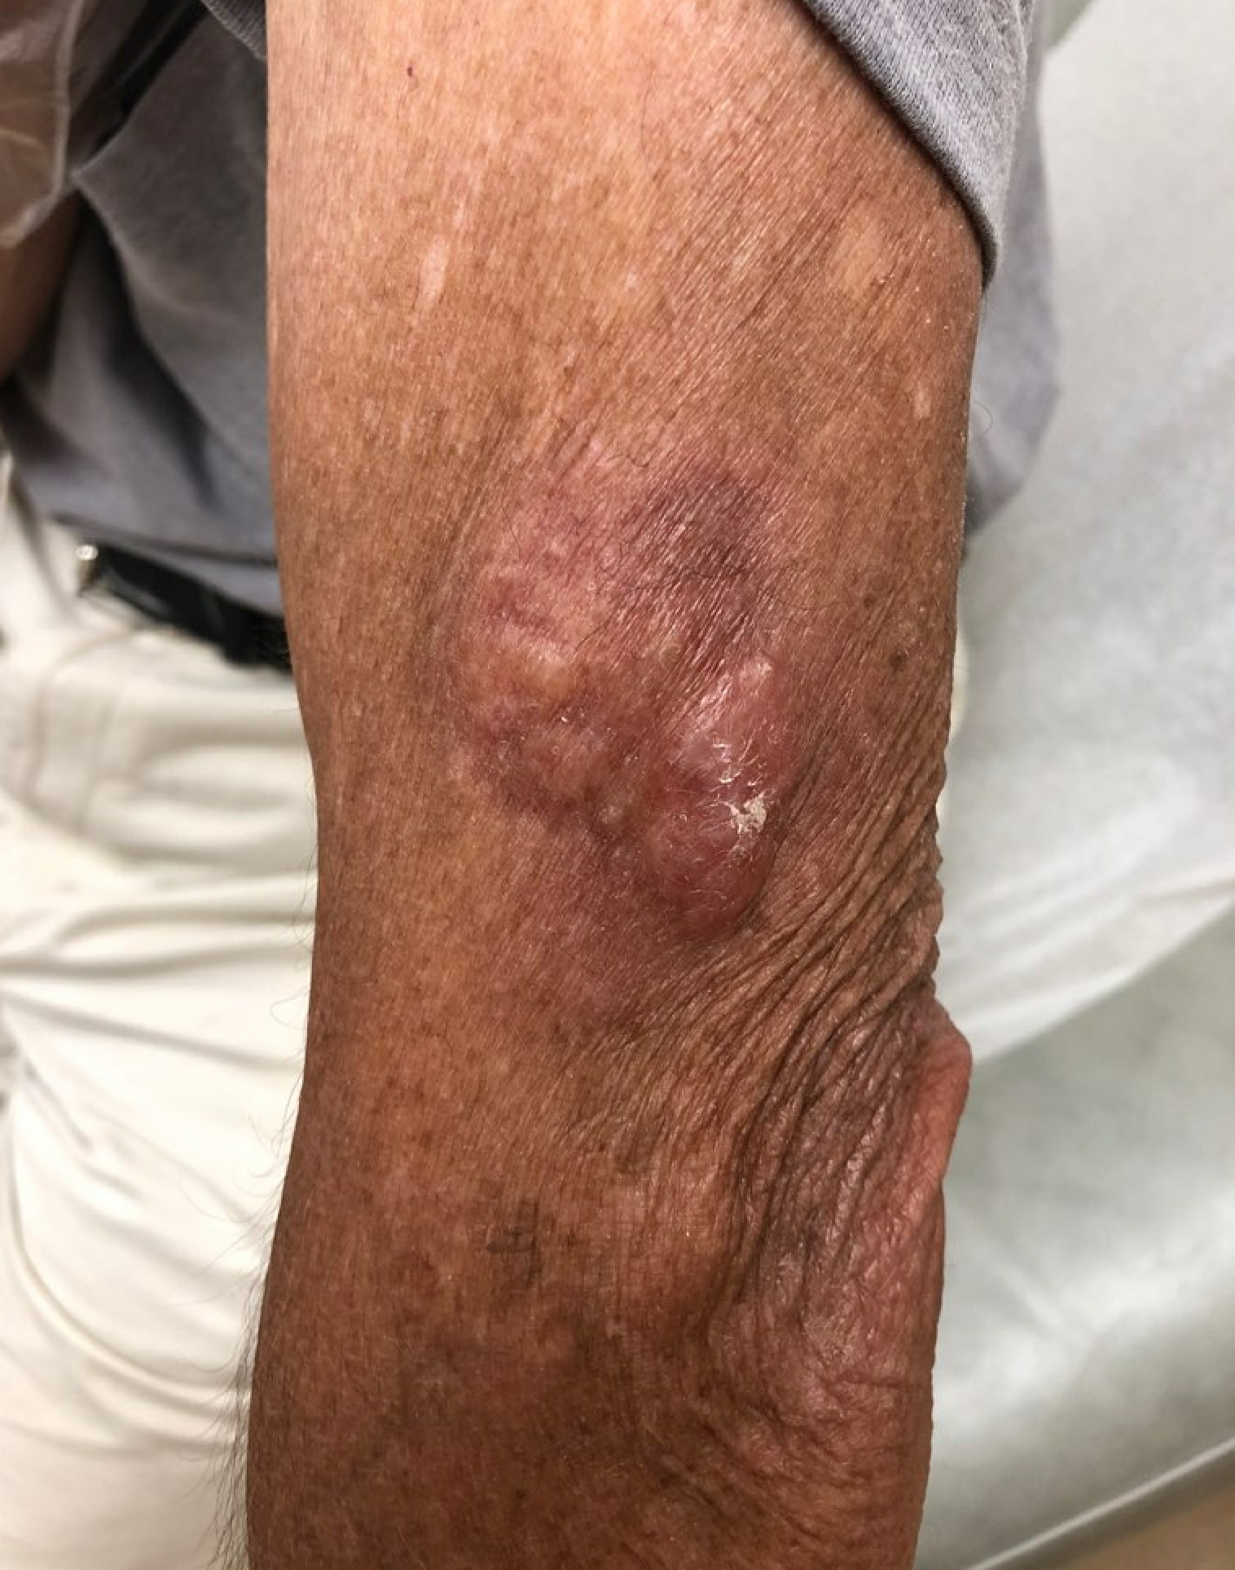
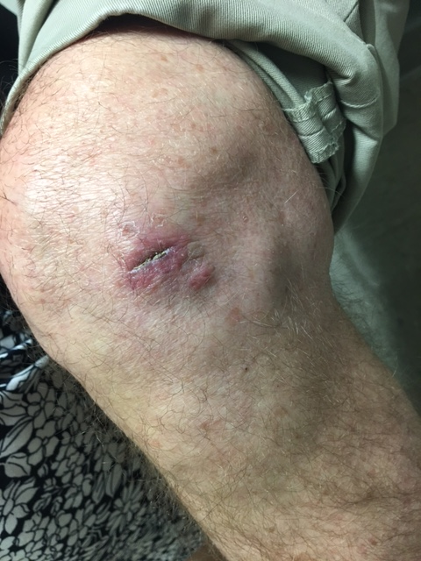
@JMGardnerMD

Slide 5
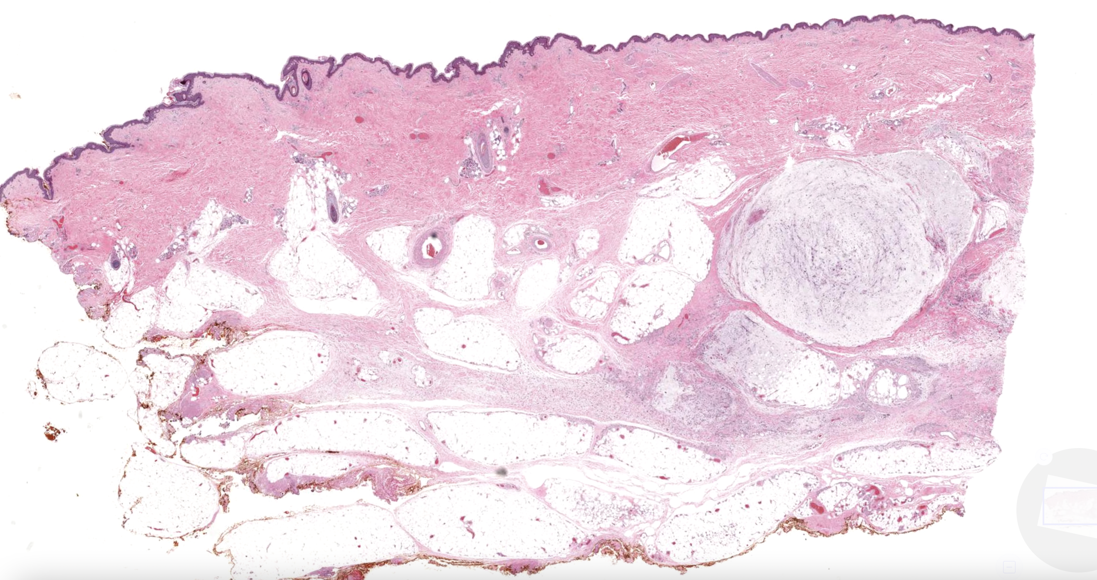
Digital slide of this case: https://kikoxp.com/posts/6807
@JMGardnerMD

Slide 6
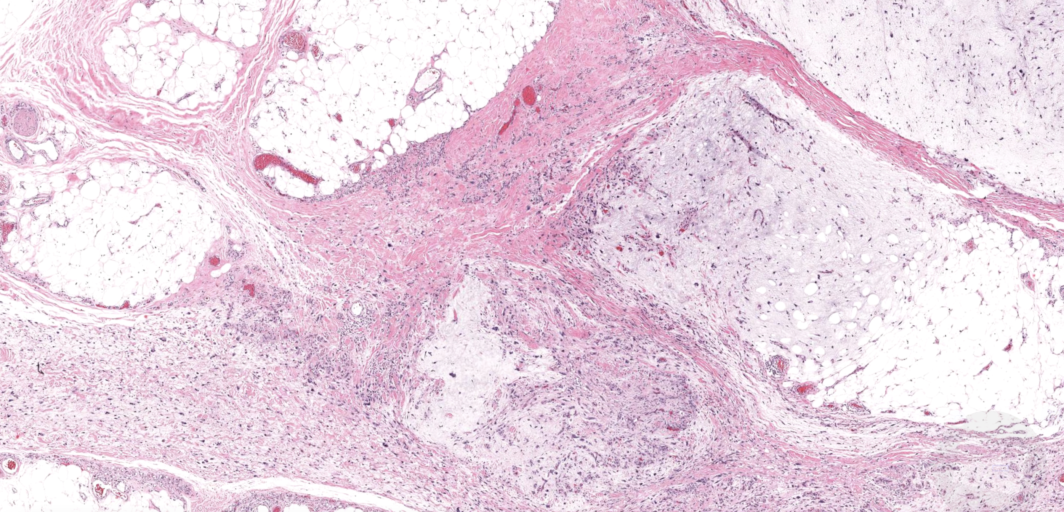
Digital slide of this case: https://kikoxp.com/posts/6807
@JMGardnerMD

Slide 7
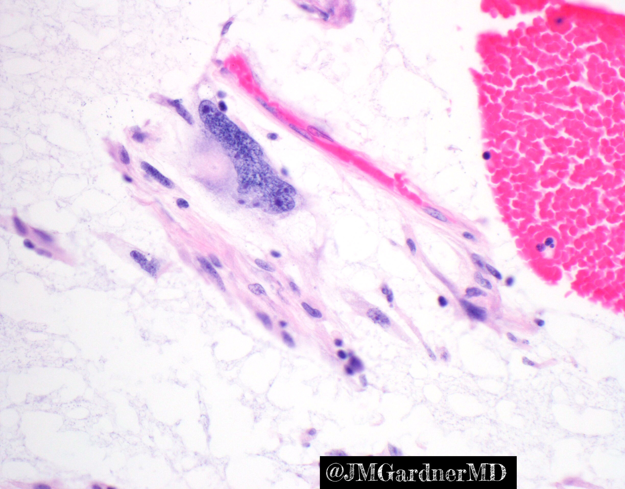

Slide 8
Myxofibrosarcoma
Relatively common compared to other sarcomas
Elderly patients on extremities
50% involve dermis/subcutis (may be clinically misdiagnosed as “cyst”)
Infiltrative along subcutaneous septa/fascia = high risk of local recurrence
If high grade, can metastasize to lungs
JMGardnerMD@gmail.com
Social Media 101: www.bit.ly/1Aaxuiz
@JMGardnerMD

Slide 9
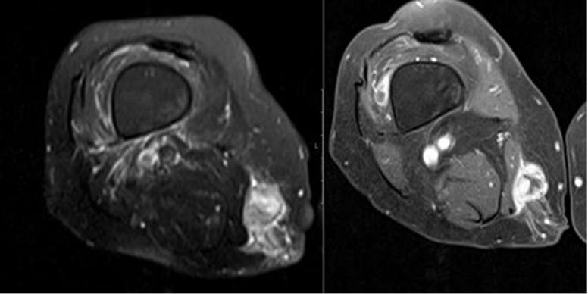
Myxofibrosarcoma
@JMGardnerMD

Slide 10
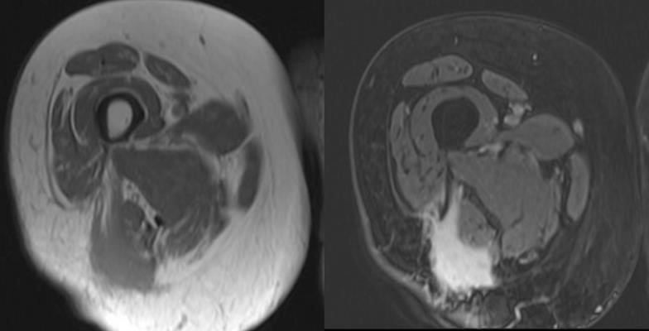
Myxofibrosarcoma
@JMGardnerMD

Slide 11
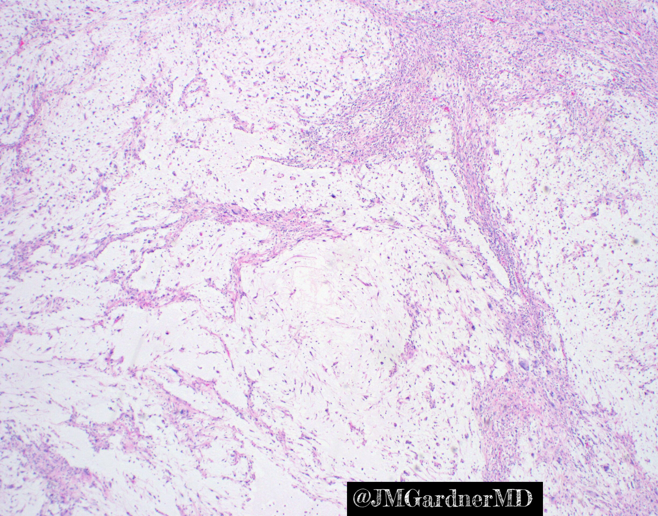
Myxofibrosarcoma

Slide 12
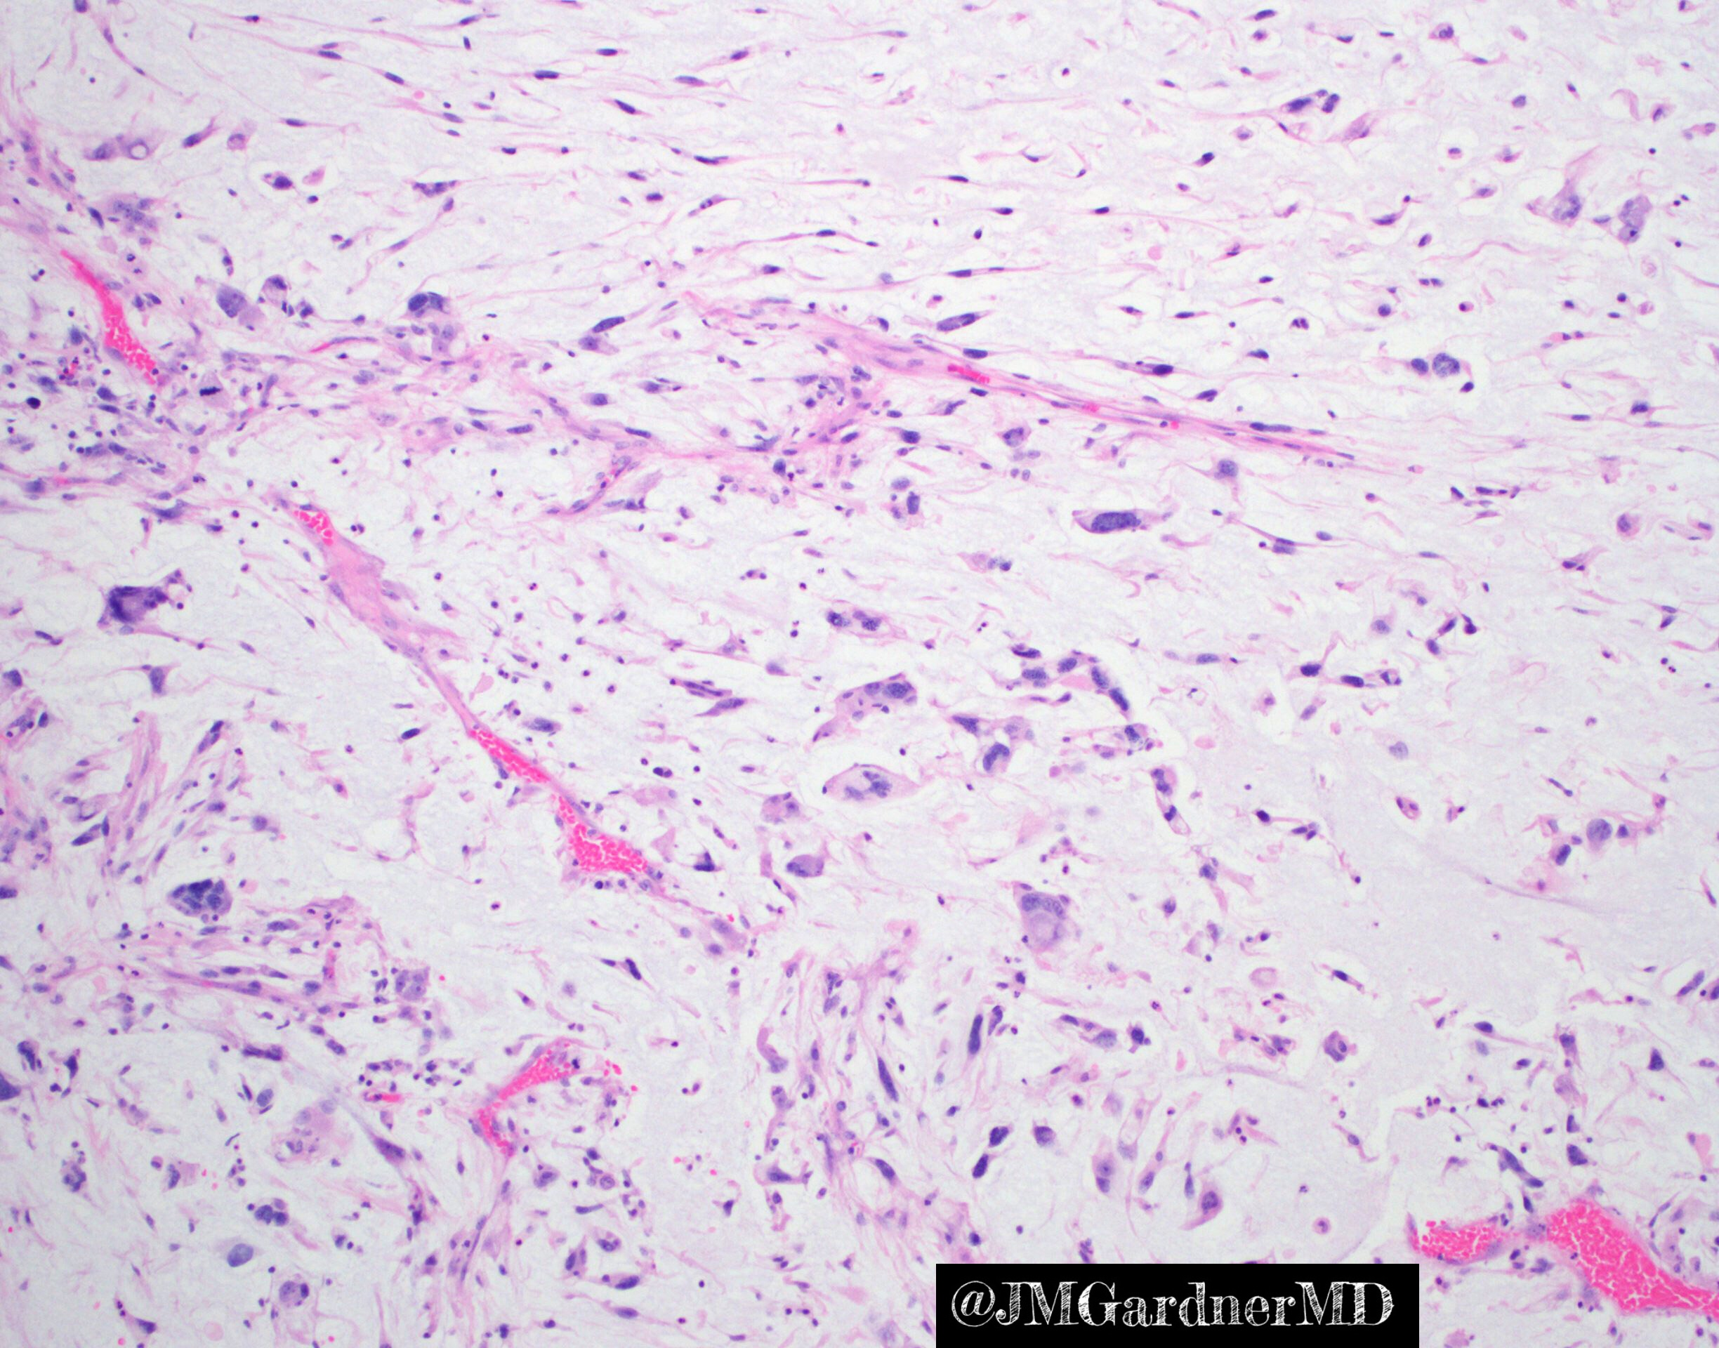
Myxofibrosarcoma

Slide 13
Myxofibrosarcoma

Slide 14
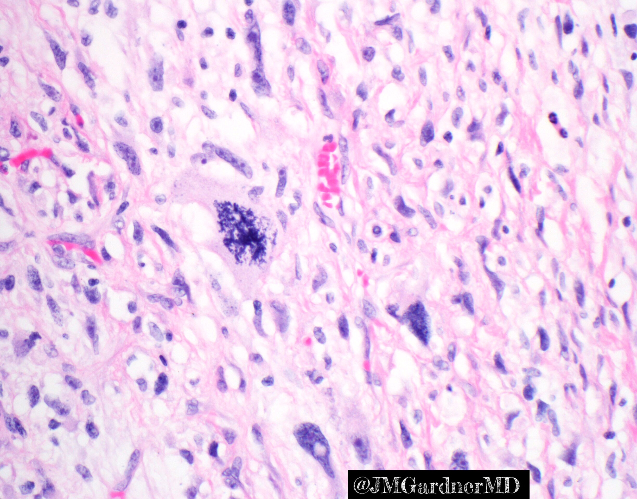
Myxofibrosarcoma

Slide 15
Digital slide of this case: https://kikoxp.com/posts/6807
@JMGardnerMD

Slide 17
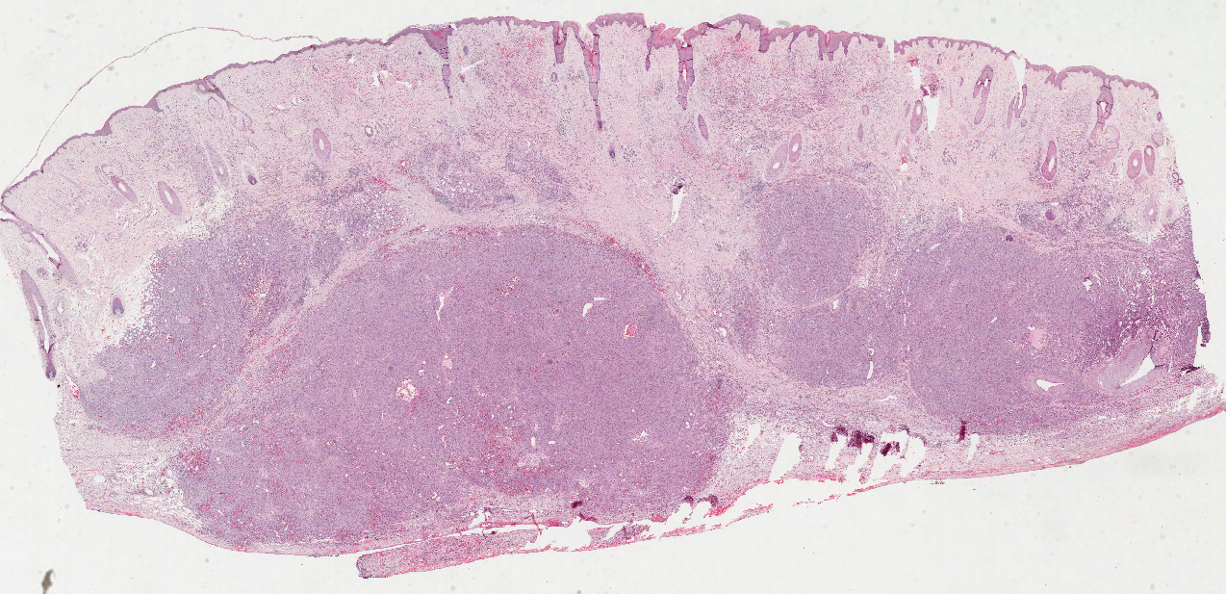
@JMGardnerMD

Slide 18
@JMGardnerMD

Slide 19
@JMGardnerMD

Slide 20
Angiosarcoma
Malignant vascular neoplasm
Skin/subcutis most common site
Head/neck of sun-damaged elderly
Post-radiation
Chronic lymphedema
Also in internal organs (heart, spleen) or deep soft tissue
@JMGardnerMD

Slide 21
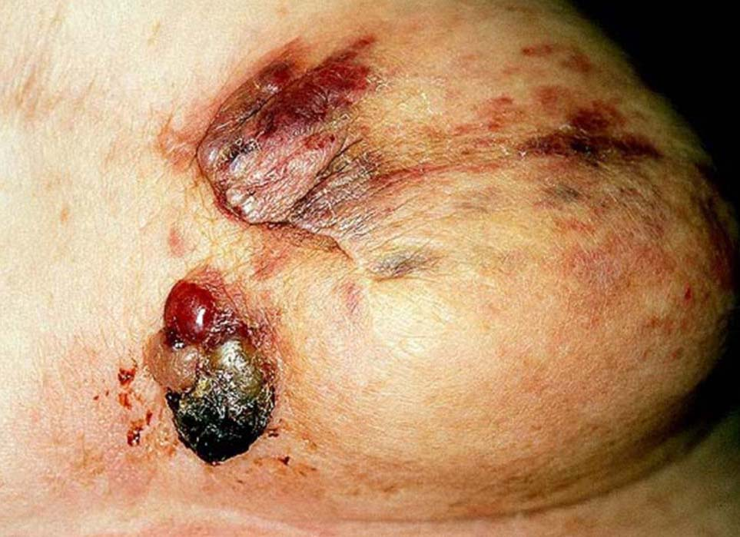
Courtesy Mark Wick, MD

Slide 22
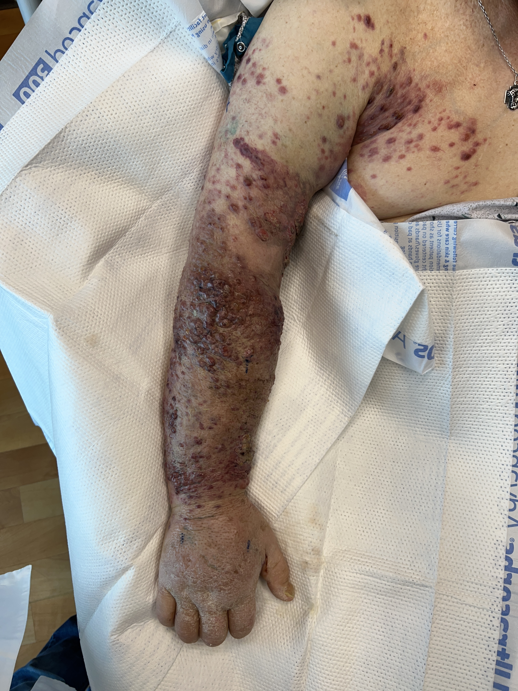
Stewart-Treves Syndrome
@JMGardnerMD

Slide 23
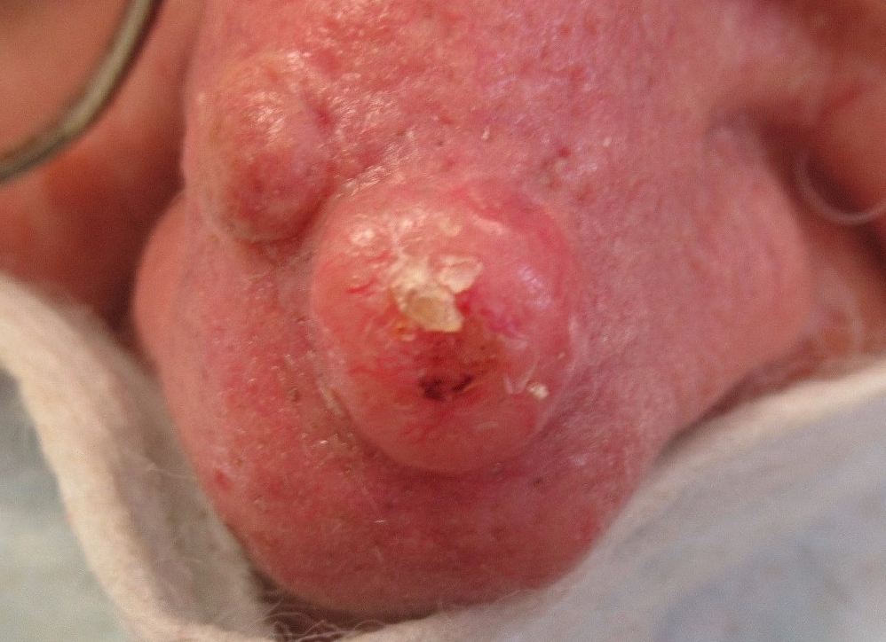

Slide 24
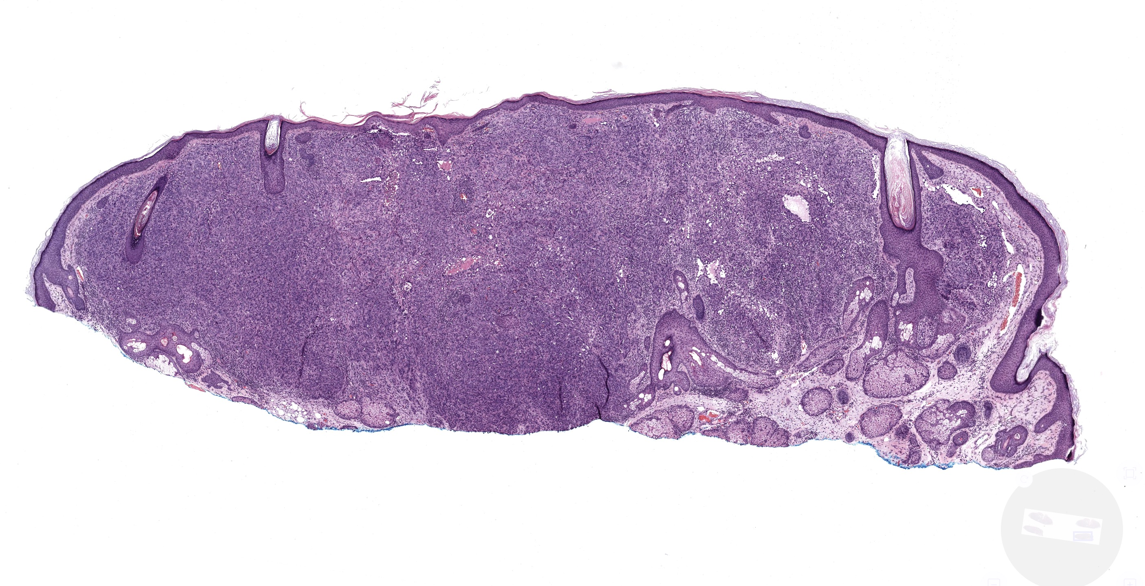
https://kikoxp.com/posts/21794

Slide 25
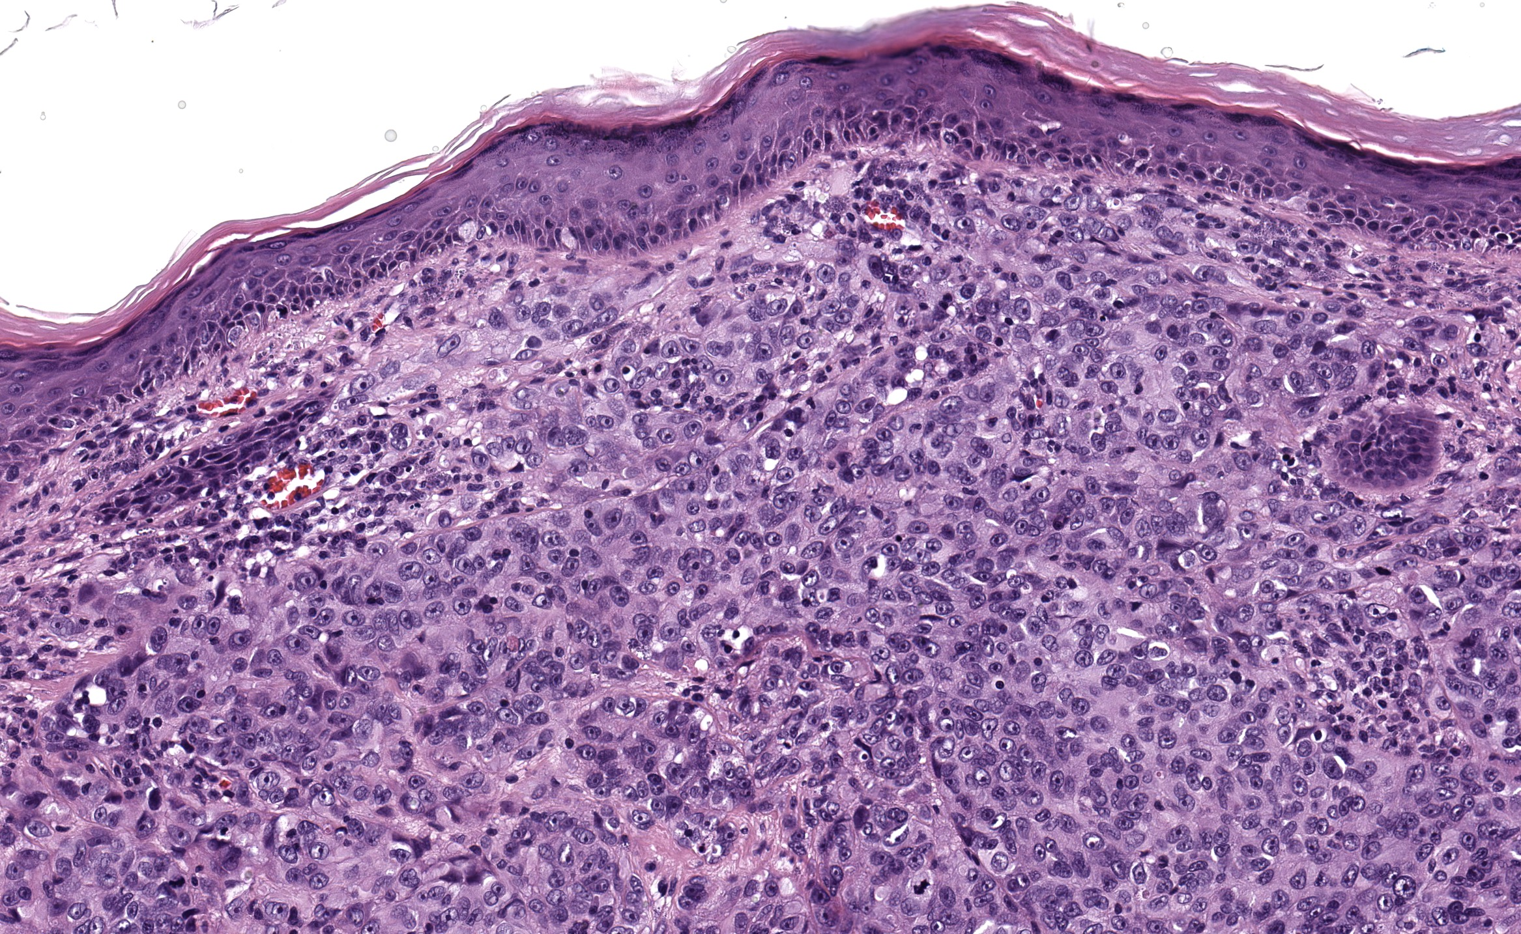
https://kikoxp.com/posts/21794

Slide 26
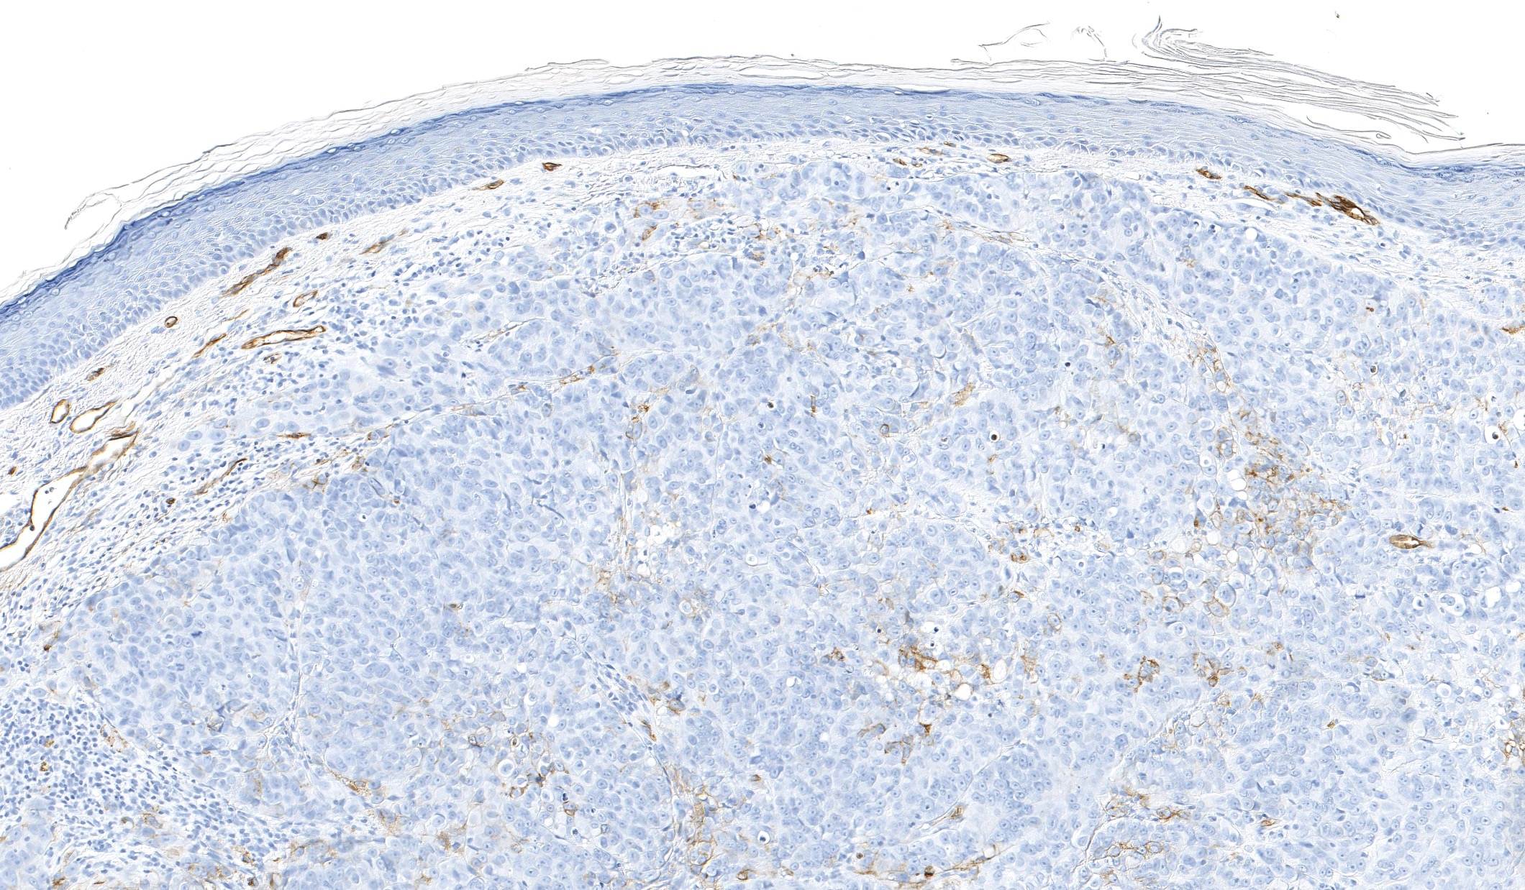
CD34
https://kikoxp.com/posts/21794

Slide 27
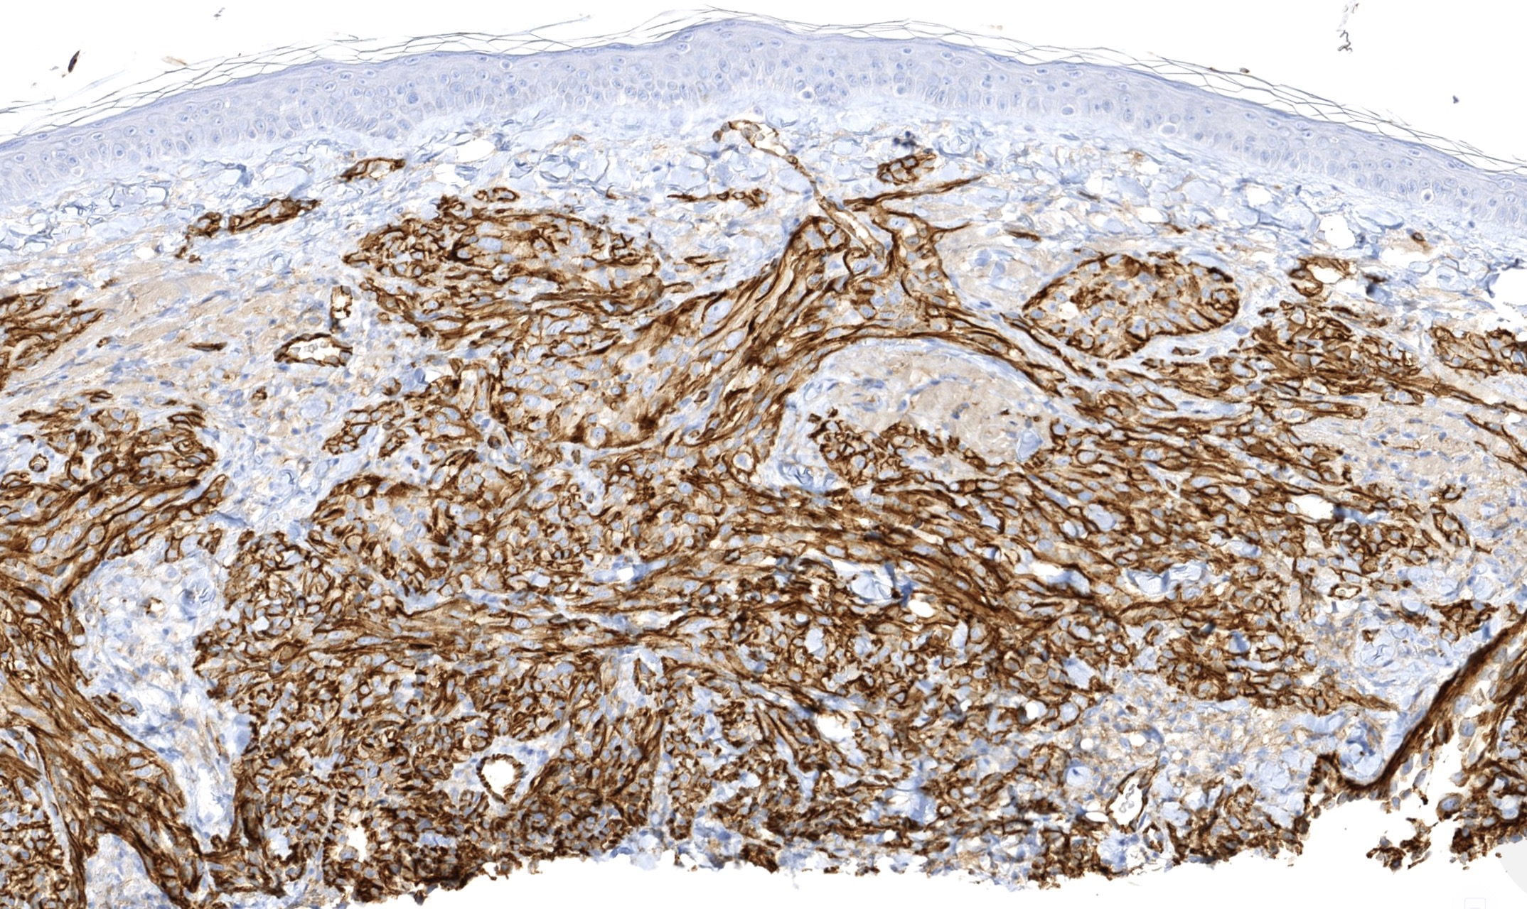
CD31

Slide 28
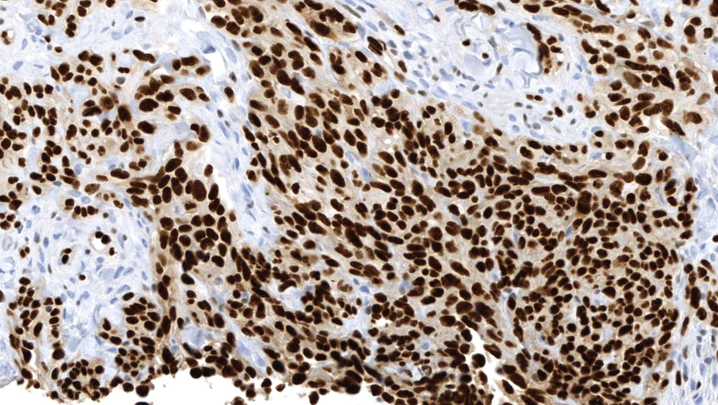
ERG
WARNING!
ERG is very sensitive but NOT SPECIFIC for vascular tumors. ERG also stains acute myeloid leukemia, prostate carcinoma, more

Slide 30
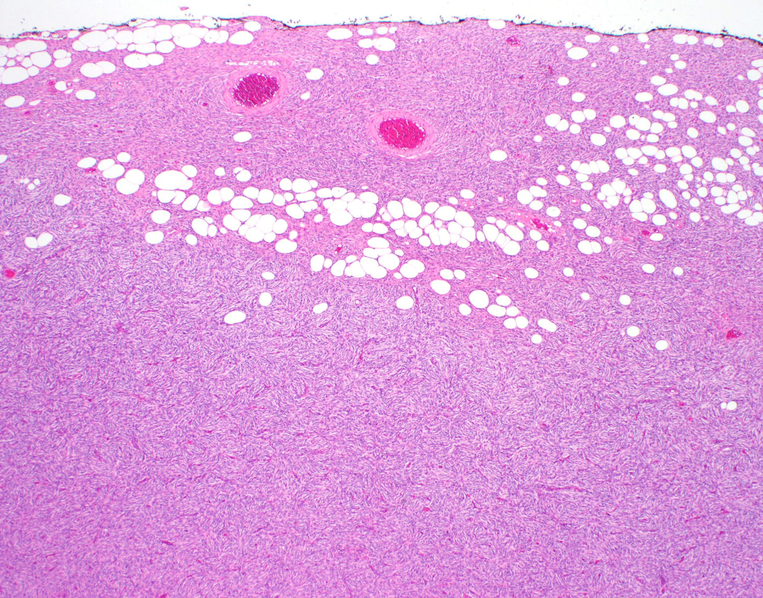
@JMGardnerMD

Slide 31
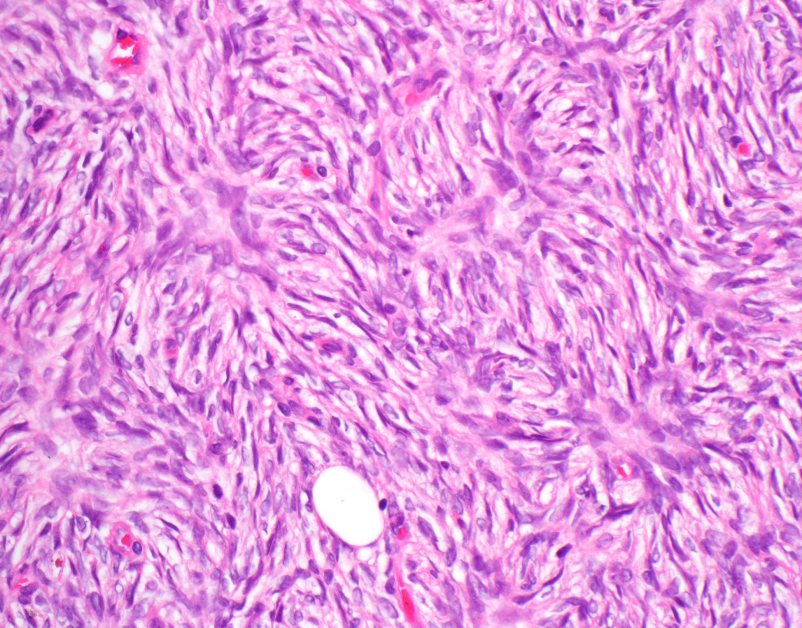

Slide 32
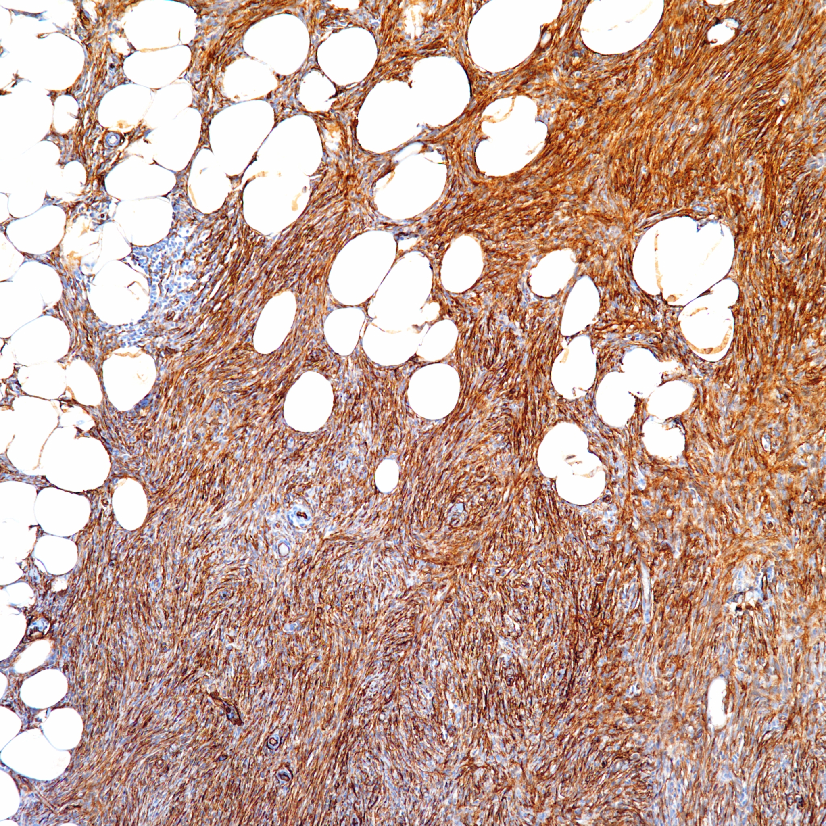
CD34

Slide 33
Dermatofibrosarcoma protuberans (DFSP)
Bland spindle cells in dermis/subcutis
Lacks pleomorphism/atypia, necrosis, atypical mitoses
CD34+ (sensitive but not specific)
Molecular/FISH (I only use in difficult cases):
t(17;22) COL1A1::PDGFB fusion
Alternate fusion of PDGFD in small subset of cases
@JMGardnerMD

Slide 34
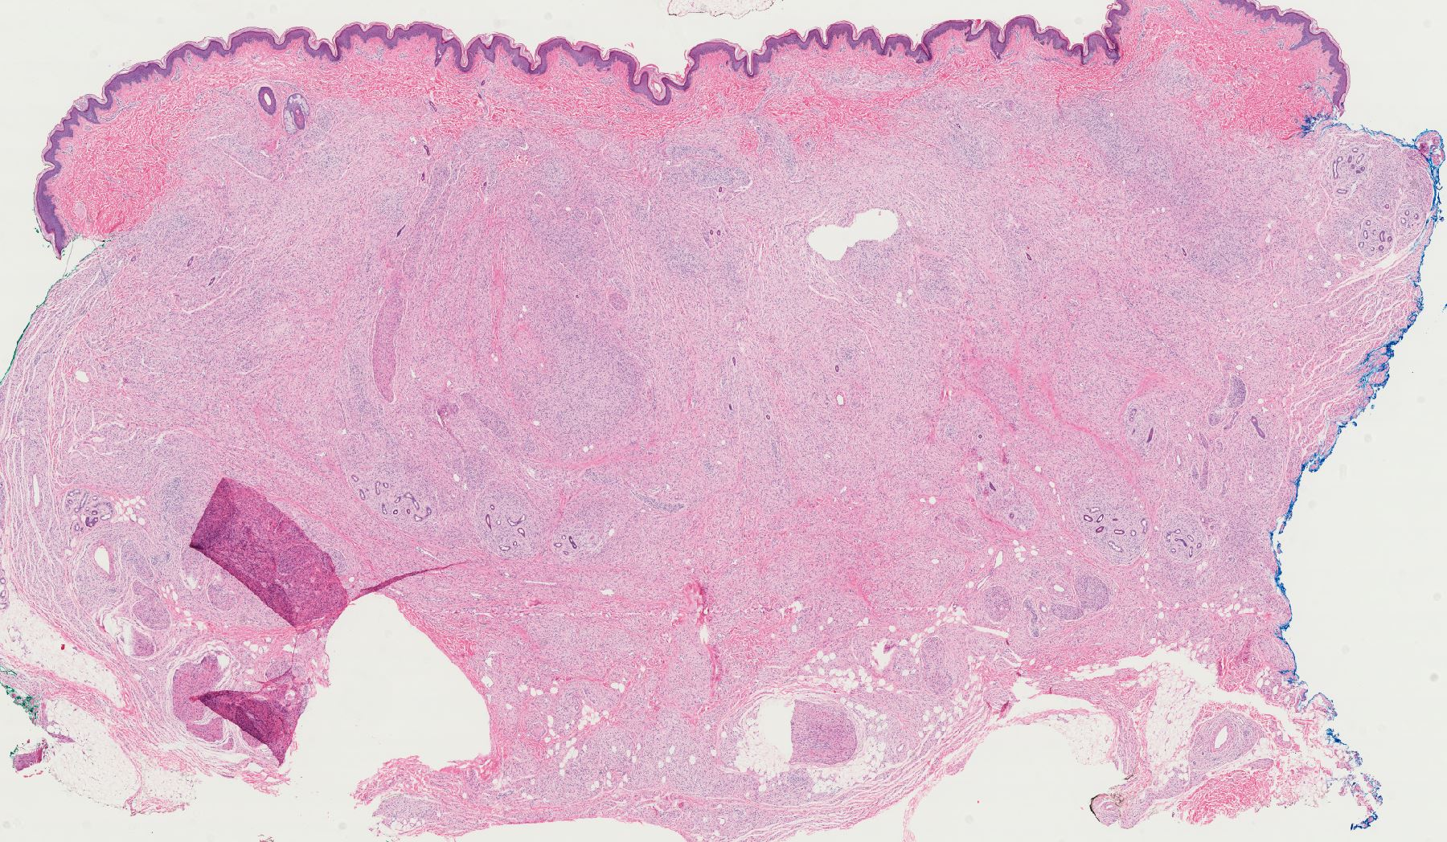

Slide 35
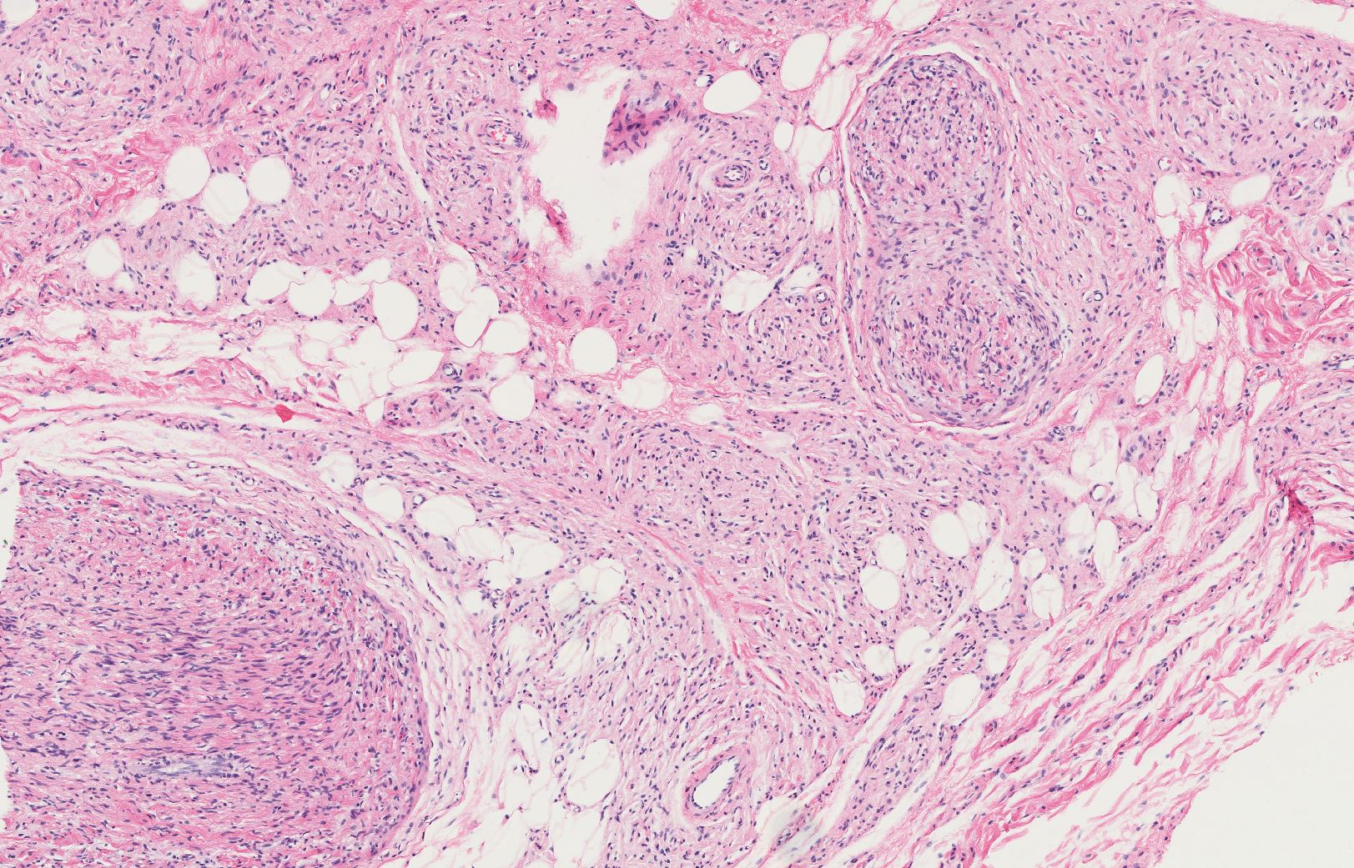

Slide 36
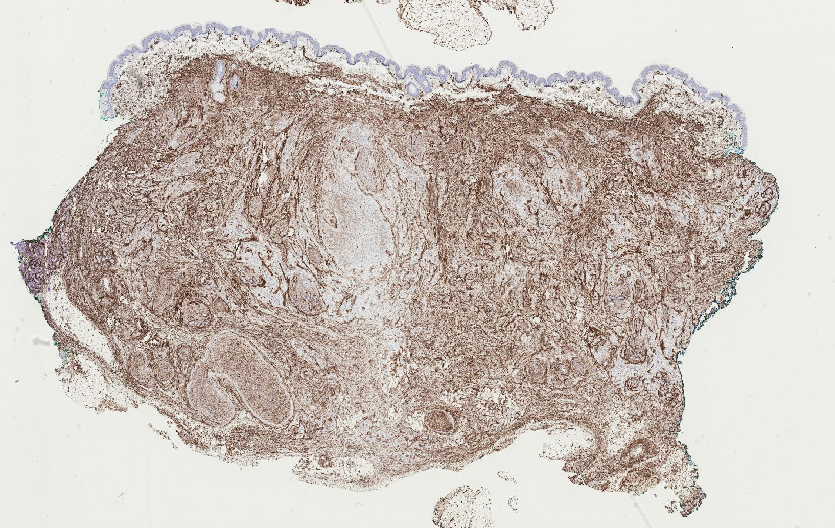
DFSP???
CD34

Slide 37
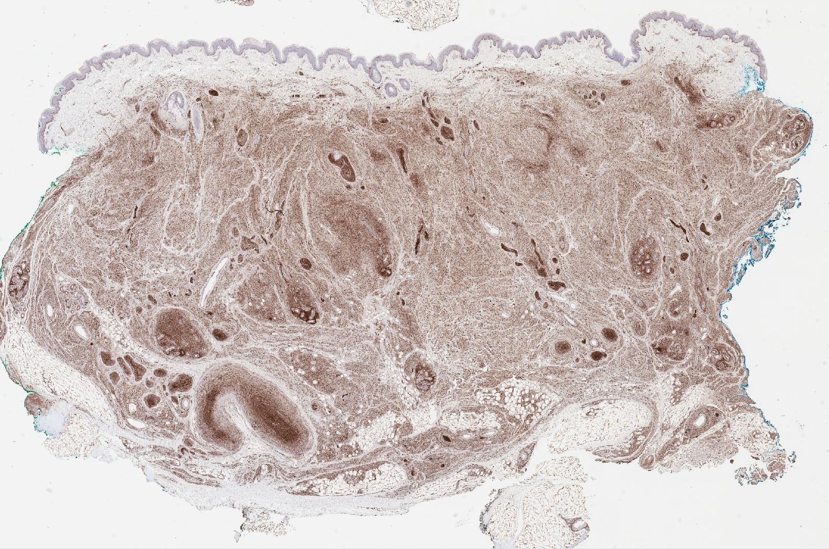
S100

Slide 38
Neurofibroma, diffuse type
Also had some plexiform-like areas
Patient had known NF-1

Slide 39
LESSONS
Fat entrapment can be see in things other than DFSP
CD34 is not specific; it stains many things other than DFSP
Most neurofibromas are CD34+
If ddx is neurofibroma vs DFSP, be sure to do S100 or SOX-10

Slide 40
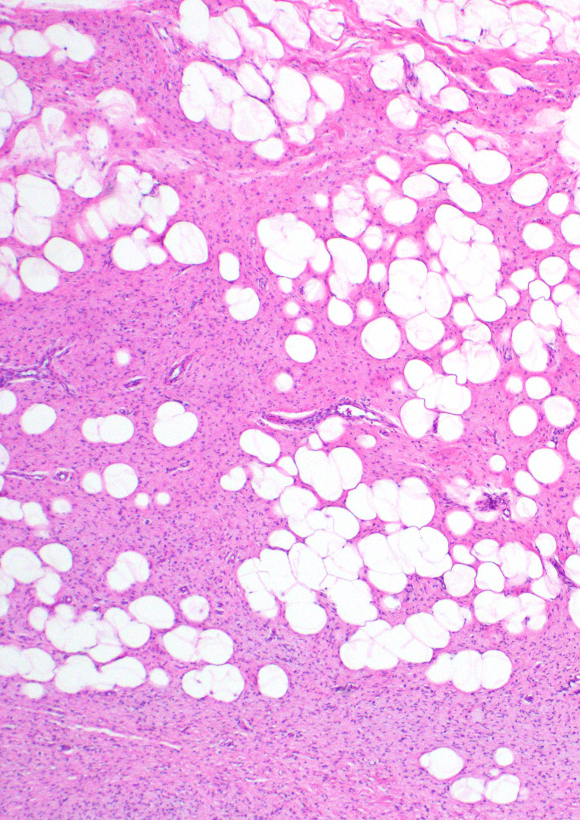
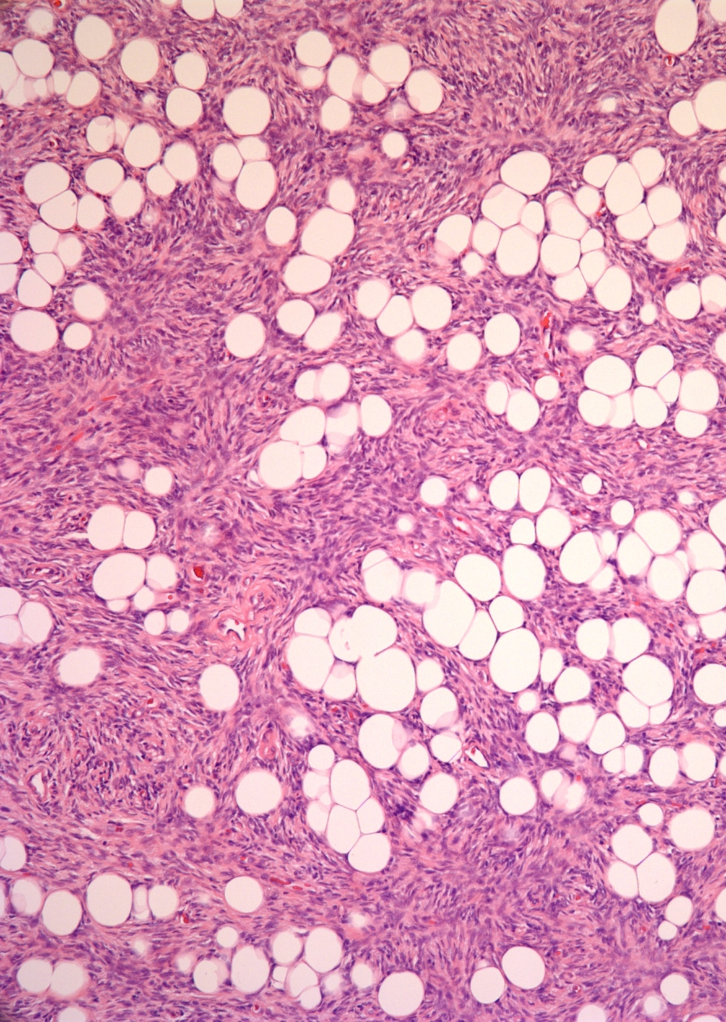
Neurofibroma
Fibrous Hamartoma of Infancy
DFSP

Slide 41
Dermatofibrosarcoma protuberans (DFSP)
Classic clinical history:
Multinodular fungating mass
Trunk of young adult
Subset occur on head/neck or extremities
Early lesions look non-specific & benign clinically
Often mimic cyst, scar, lipoma, dermatofibroma
Delay in diagnosis

Slide 42
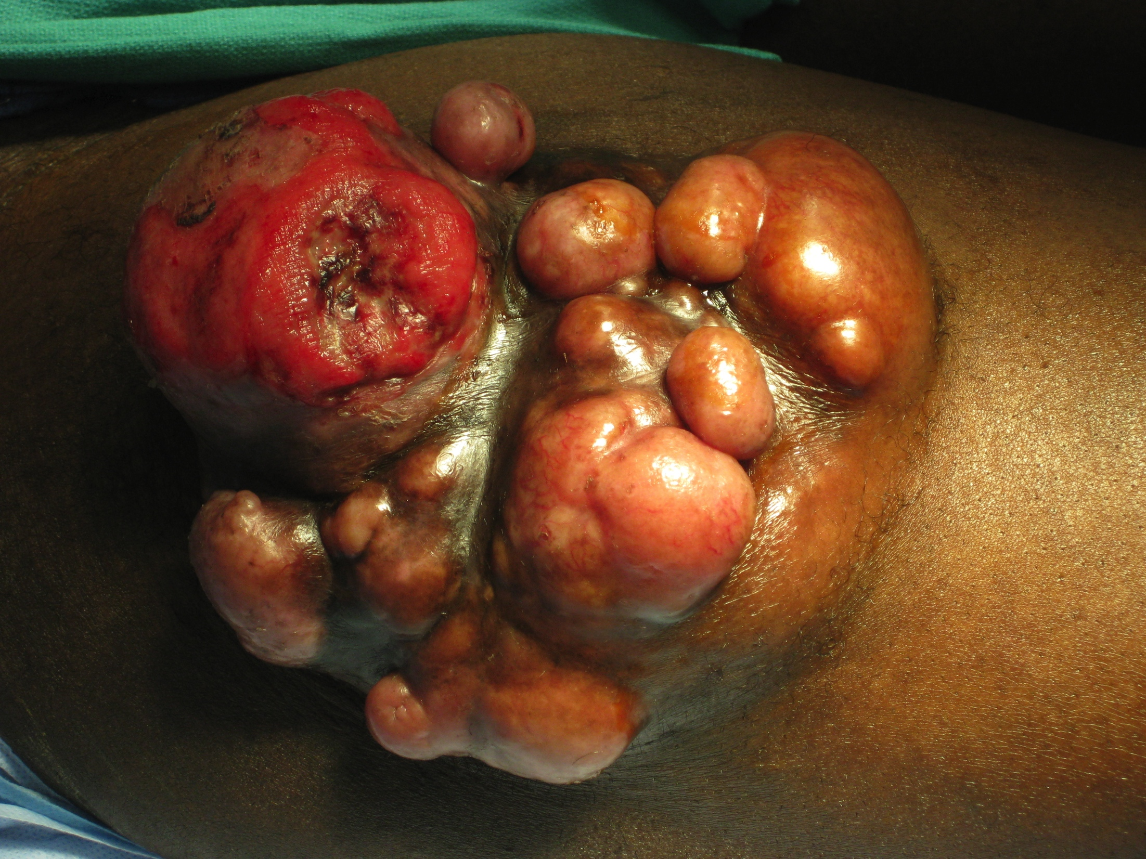
http://www.orthopaedicsone.com/pages/viewpage.action?pageId=19071207

Slide 43
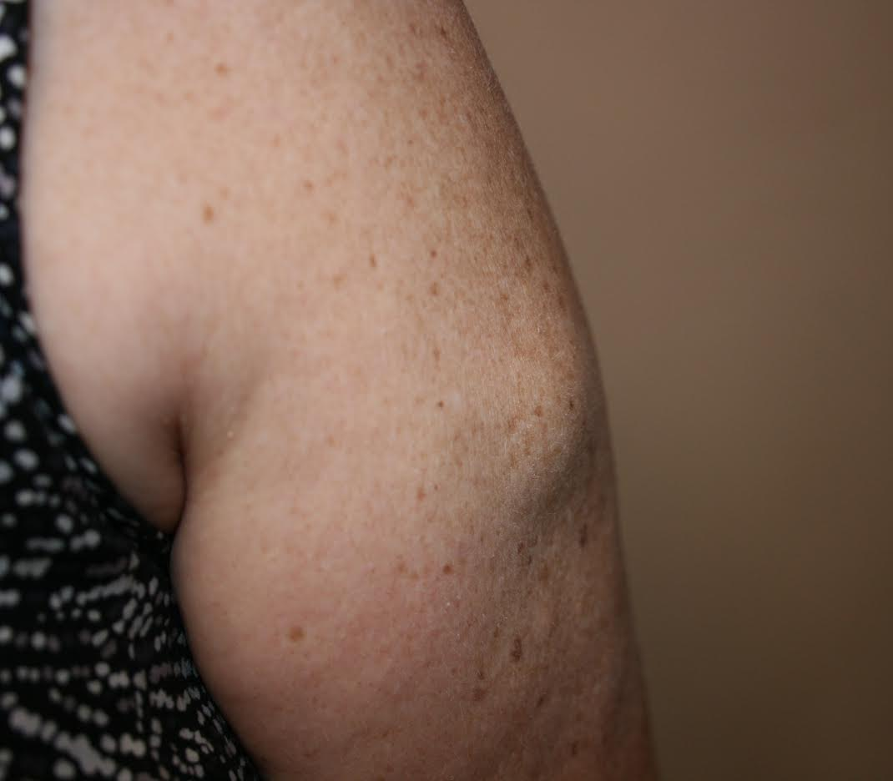

Slide 44
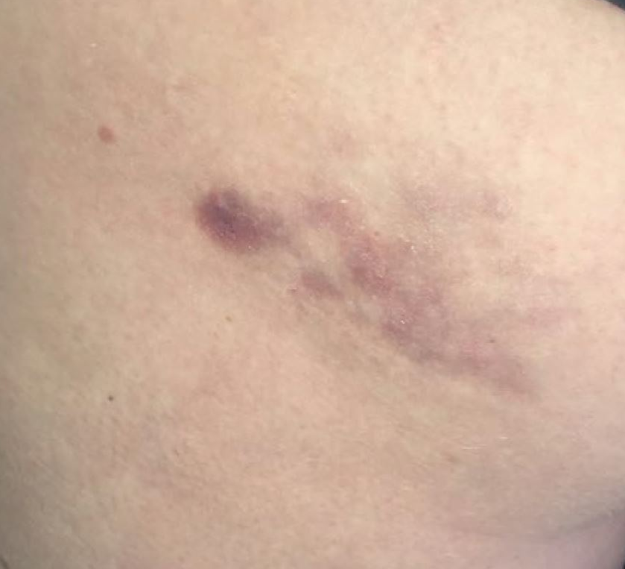

Slide 45
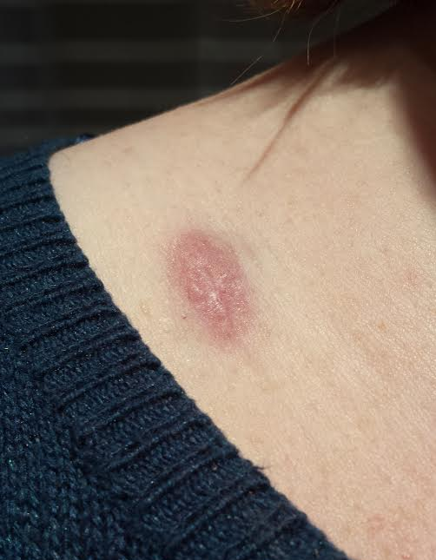
@JMGardnerMD

Slide 47
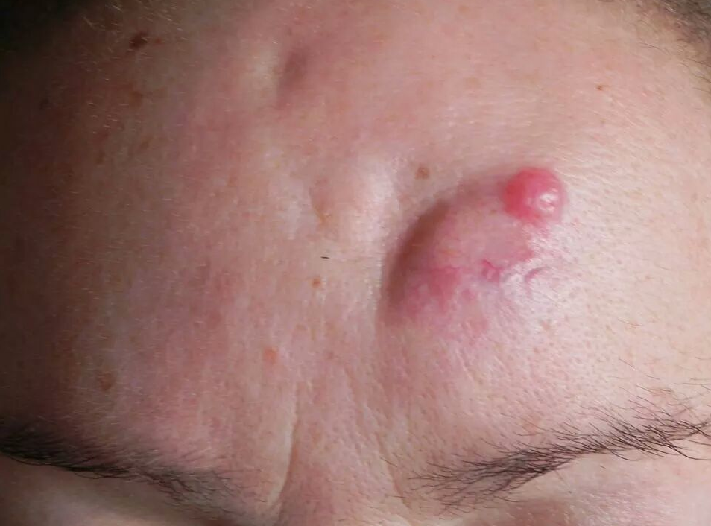

Slide 48
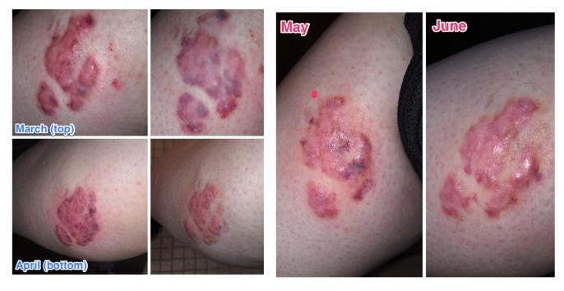
This was treated for YEARS as a KELOID

Slide 49
5 DFSP patient co-authors helped design study!

Slide 50
@JMGardnerMD

Slide 51
@JMGardnerMD

Slide 52
@JMGardnerMD

Slide 53
@JMGardnerMD

Slide 54
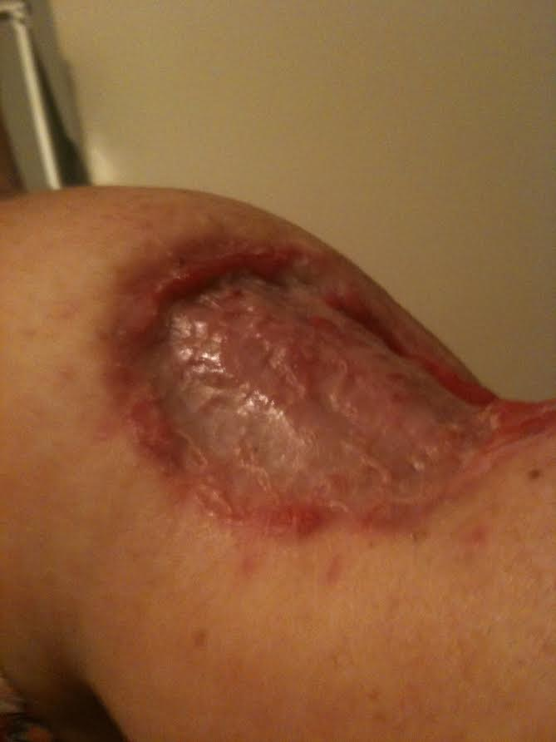

Slide 55
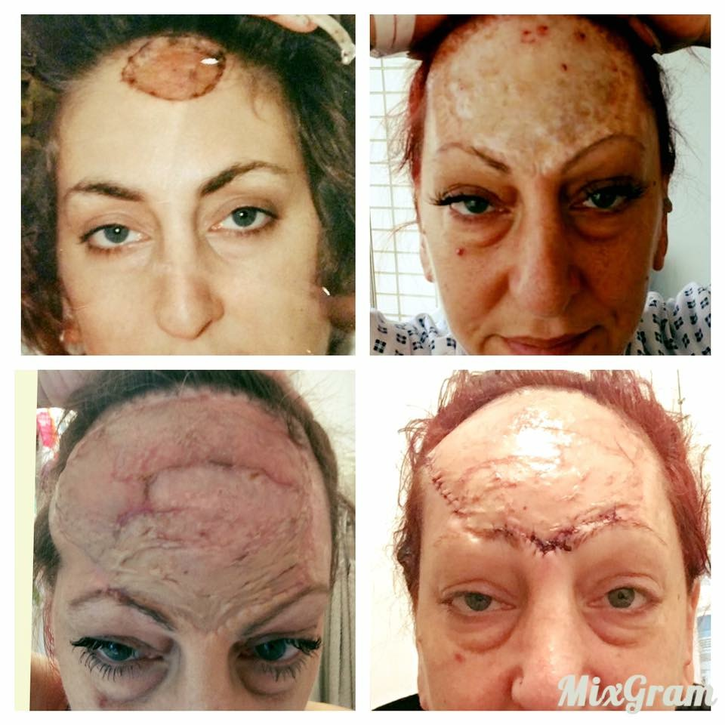

Slide 57
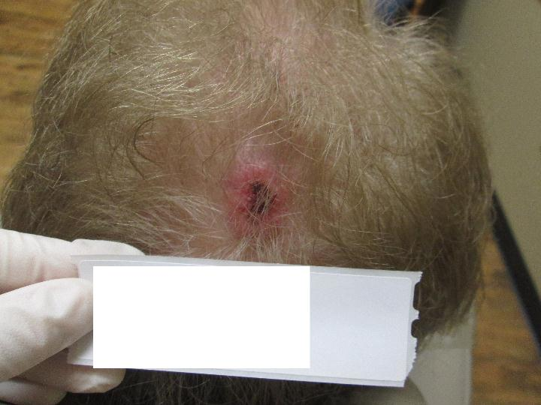
@JMGardnerMD

Slide 58
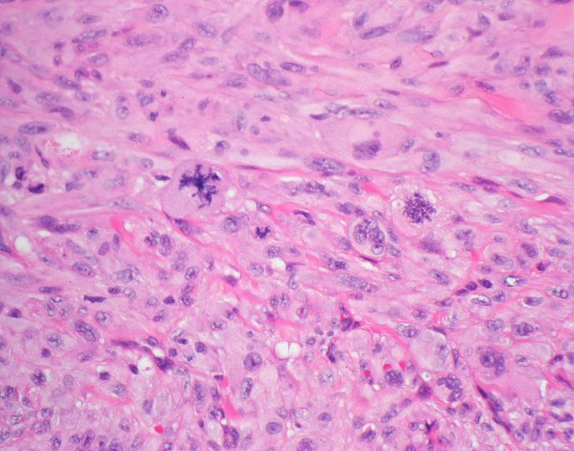
@JMGardnerMD

Slide 59
pleomorphic spindle cell tumor on Head/neck of elderly
Main Differential Diagnosis:
Spindle cell melanoma (S100+, SOX-10+)
Spindle cell SCC (p63/p40+, keratin+)
Atypical fibroxanthoma (AFX) & pleomorphic dermal sarcoma (PDS)
No specific positive immunostain marker exists for AFX/PDS
CD68, CD10, procollagen I, vimentin: positive but non-specific
(I don’t use these)
Additional Entities in Differential:
Spindled angiosarcoma (CD31+, ERG+)
Leiomyosarcoma (desmin+)
Rhabdomyosarcoma (desmin+, myogenin+, myoD1+)
Other sarcomas
The panel I like:
SOX-10
CK5/6
P40
Desmin
ERG
@JMGardnerMD

Slide 60
Atypical fibroxanthoma (AFX) &
Pleomorphic dermal sarcoma (PDS)
Superficial variant of pleomorphic sarcoma due to chronic sun damage
Crusted erythematous nodule or papule on head/neck of elderly (looks like SCC)
AFX (confined to dermis & no high risk features*) – excellent prognosis
PDS (invades subcutis or has high risk features*) – may metastasize
*High risk features: Subcutaneous invasion, size > 2cm, necrosis, perineural invasion
JMGardnerMD@gmail.com
Social Media 101: www.bit.ly/1Aaxuiz
@JMGardnerMD

Slide 61
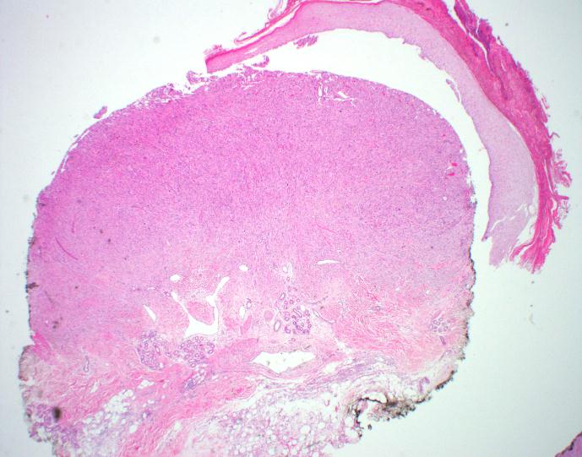
Atypical fibroxanthoma (AFX)
@JMGardnerMD

Slide 62
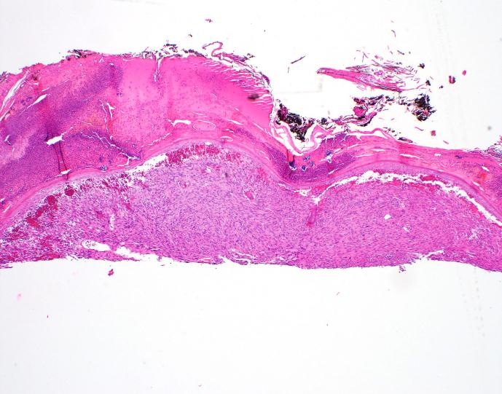
AFX vs PDS?
No way to know how deep it goes on transected shave biopsy!
@JMGardnerMD

Slide 63
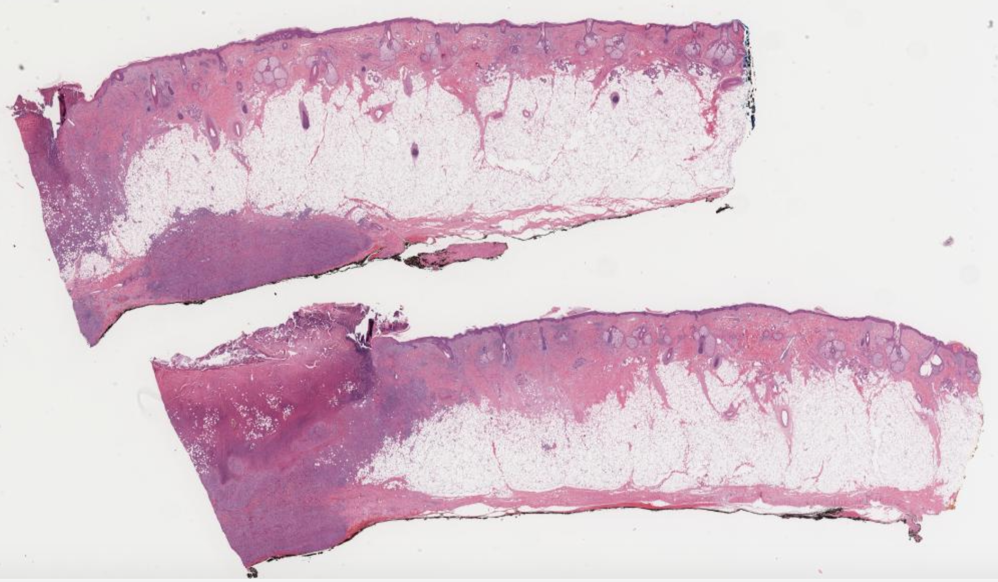
Pleomorphic dermal sarcoma!
@JMGardnerMD
@JMGardnerMD

Slide 64
Pleomorphic Dermal Sarcoma
Looks/stains identical to AFX, but…it invades SUBCUTIS
(and/or has necrosis, perineural invasion, or is larger than 2 cm)
Risk of metastasis/mortality (up to 30% in some studies)
On Mohs of AFX vs PDS, must examine debulk specimen microscopically to see if subcutis invasion
@JMGardnerMD

